Slide 1
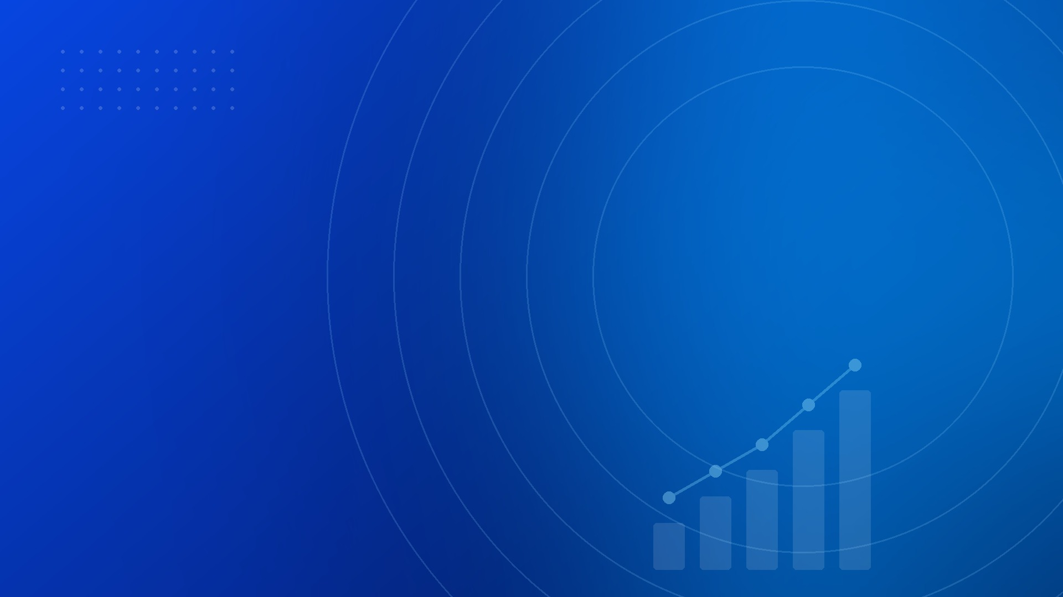
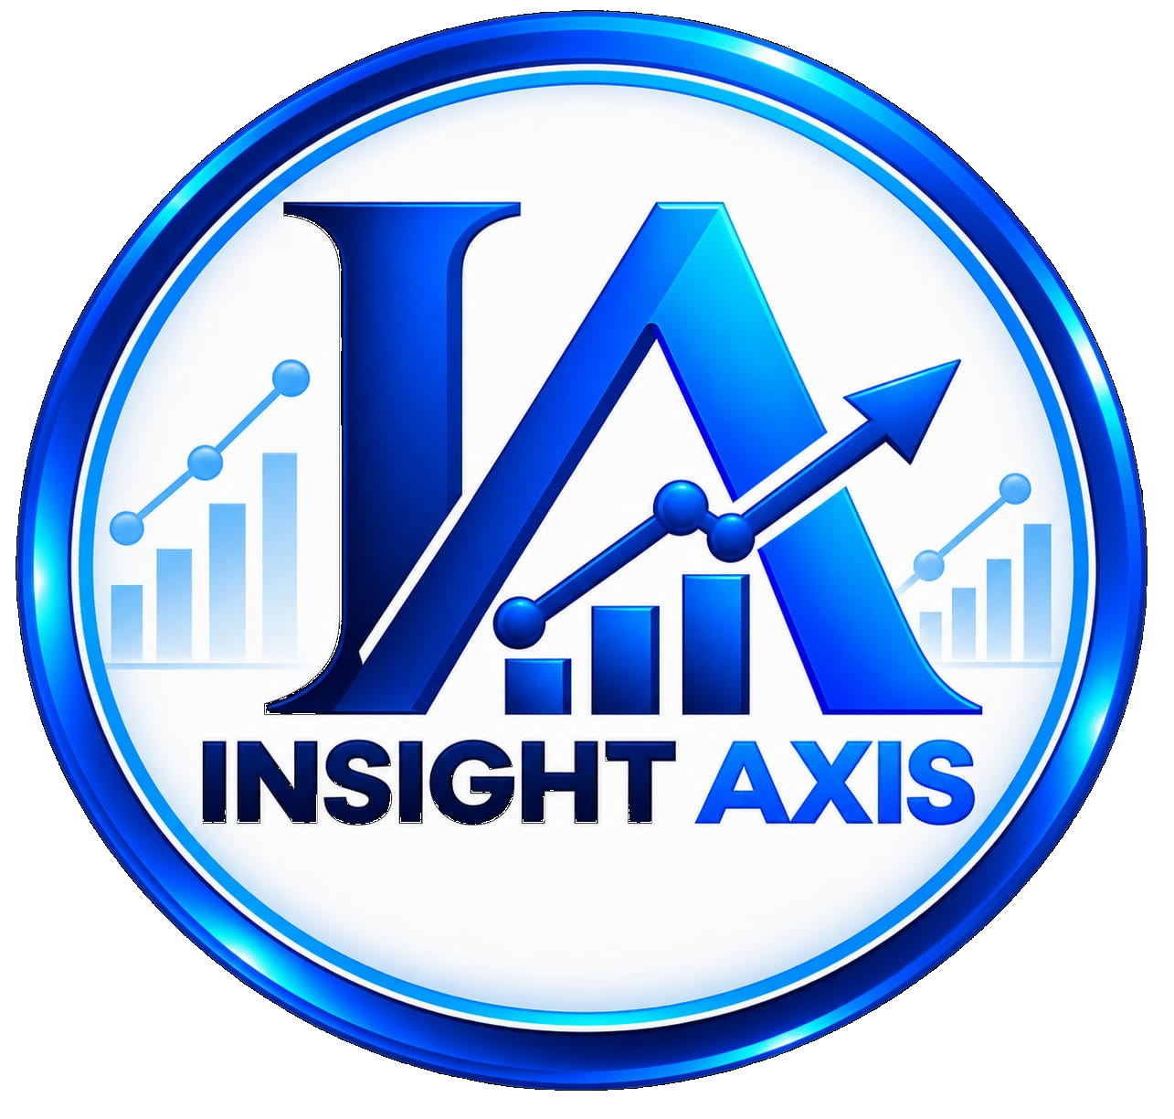
☎ +91 99066 01124
🌐 www.insightaxisai.com
PYTHON FUNDAMENTALS
Lecture 1 — Introduction to Python
History • Why Python • Applications • Benefits
Requirements • Prerequisites • IDEs • Learning Roadmap
A BEGINNER-FRIENDLY INTRODUCTION
INSIGHT AXIS • PYTHON FUNDAMENTALS • LECTURE 1 • 1

Slide 2
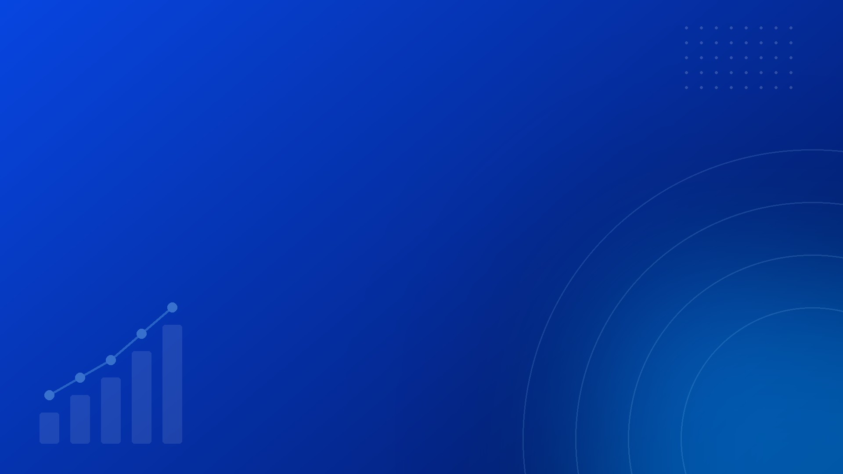
01
What Is Python?
Python is a high-level, general-purpose language for readable coding.
Python lets us give instructions to a computer through code.
High-level means we use human-friendly concepts, not machine code.
General-purpose means it works in many different areas.
Its syntax is readable, clean, and simple.
It supports procedural, object-oriented, and functional styles.
INSIGHT AXIS • PYTHON FUNDAMENTALS • LECTURE 1 • 2

Slide 3

02
Why Was Python Created?
Python was designed to be clear, easy to write, and easy to maintain.
Guido van Rossum created Python and released it in 1991.
A key design goal was readability.
It cuts unnecessary syntax and repetitive boilerplate.
Developers focus on the problem, not complicated syntax.
It is practical, extensible, and backed by reusable libraries.
INSIGHT AXIS • PYTHON FUNDAMENTALS • LECTURE 1 • 3

Slide 4

03
What Is the History of Python?
Python has evolved for over three decades; Python 3 is the modern standard.
1989 — Guido van Rossum began developing Python.
1991 — The first public release became available.
2000 — Python 2.0 brought major improvements.
2008 — Python 3.0 modernized the language.
2020 — Python 2 support ended; Python 3 is the standard.
INSIGHT AXIS • PYTHON FUNDAMENTALS • LECTURE 1 • 4

Slide 5
04
Why Should We Learn Python?
Python is simple for beginners and still powerful for advanced work.
Easy readability — focus on logic, not syntax.
Fast development — useful tasks in few lines of code.
Versatility — automation, web, data, testing, and AI/ML.
Large ecosystem — libraries for many technical fields.
Strong community — great docs, tutorials, and projects.
INSIGHT AXIS • PYTHON FUNDAMENTALS • LECTURE 1 • 5

Slide 6
05
Why Python and Not Java?
Java is powerful; Python is a simpler starting point for this course.
Python needs less syntax, so beginners focus on logic.
Python is widely used in automation, data, and AI/ML.
Java is strong in enterprise and large software systems.
Learn Java when your projects need its ecosystem.
Java is not bad — Python simply fits our beginner-first goal.
INSIGHT AXIS • PYTHON FUNDAMENTALS • LECTURE 1 • 6

Slide 7
06
Why Python and Not C or C++?
C and C++ offer speed and control; Python offers readability and productivity.
C and C++ suit operating systems, games, and embedded software.
Python hides low-level details, which helps beginners.
Python is quicker to write and easier to read.
C and C++ matter when memory control and speed are critical.
Python lets us learn concepts before low-level complexity.
INSIGHT AXIS • PYTHON FUNDAMENTALS • LECTURE 1 • 7

Slide 8
07
Why Python and Not JavaScript?
JavaScript leads browser web; Python leads general coding, data, and AI.
JavaScript powers interactive web pages and servers.
Python is used for automation, data, backend, and AI/ML.
Both languages are versatile with large ecosystems.
The right choice depends on the project.
Python gives us a clear route into programming, data, and AI.
INSIGHT AXIS • PYTHON FUNDAMENTALS • LECTURE 1 • 8

Slide 9
08
What Can We Do With Python?
Python is general-purpose, so it builds solutions across many technical areas.
Web development — websites, APIs, and dashboards.
Automation — repetitive file and report tasks.
Data analysis — clean, analyze, visualize data.
AI/ML — prepare data and train models.
Testing and DevOps — tests and deployment scripts.
Scientific computing — simulations and research.
INSIGHT AXIS • PYTHON FUNDAMENTALS • LECTURE 1 • 9

Slide 10
09
What Are the Real-World Uses of Python?
Python solves real business, research, and engineering problems.
A company automates its monthly reports.
A data analyst cleans records and builds visualizations.
A developer builds an API so apps can communicate.
A researcher runs calculations and simulations.
An ML team prepares data and trains models.
INSIGHT AXIS • PYTHON FUNDAMENTALS • LECTURE 1 • 10

Slide 11
10
What Are the Benefits of Learning Python?
Learning Python gives you a programming foundation and a practical tool.
Programming foundation — loops, functions, debugging.
Problem solving — break big problems into steps.
Productivity — turn manual work into programs.
Data skills — a path to analysis and ML.
Project building — from scripts to full apps.
Transferable concepts — apply to other languages.
INSIGHT AXIS • PYTHON FUNDAMENTALS • LECTURE 1 • 11

Slide 12
11
What Are the Requirements to Start Python?
You do not need expensive hardware or an advanced background.
A normal laptop or desktop is enough.
Windows, macOS, and Linux all support Python.
Install Python 3 and learn to run a program.
Choose an editor or IDE for coding and debugging.
Internet helps with docs, packages, and tutorials.
Hands-on practice beats watching lectures.
INSIGHT AXIS • PYTHON FUNDAMENTALS • LECTURE 1 • 12

Slide 13
12
What Are the Prerequisites?
You can start Python with no previous programming experience.
Basic computer knowledge — files, folders, installing software.
Basic logical thinking — following steps carefully.
Basic mathematics is enough to begin.
Basic English helps with documentation and error messages.
Most important — willingness to practice and try again.
INSIGHT AXIS • PYTHON FUNDAMENTALS • LECTURE 1 • 13

Slide 14
13
Which Software or IDE Can We Use?
Different tools suit different learning and project styles.
VS Code — flexible editor with debugging.
PyCharm — full-featured Python IDE.
IDLE — simple environment that comes with Python.
Jupyter Notebook — great for data and experiments.
Google Colab — browser notebooks for data and AI.
Terminal or Command Prompt — run Python files.
INSIGHT AXIS • PYTHON FUNDAMENTALS • LECTURE 1 • 14

Slide 15
14
What Is Our Python Learning Roadmap?
We move from basic syntax to problem solving, then to practical projects.
Step 1 — Installation: Python 3 and an editor/IDE.
Step 2 — Fundamentals: variables, data types, input.
Step 3 — Logic: conditions, loops, functions.
Step 4 — Data structures: lists, sets, dictionaries.
Step 5 — Projects: files, modules, APIs, automation.
Step 6 — Advanced: data analysis, ML, web development.
INSIGHT AXIS • PYTHON FUNDAMENTALS • LECTURE 1 • 15

Slide 16
☎ +91 99066 01124
🌐 www.insightaxisai.com
THANK YOU
Keep learning. Keep practicing.
Keep building with Python!
See you in Lecture 2 — Python Basics
INSIGHT AXIS • PYTHON FUNDAMENTALS • LECTURE 1 • 16

